Slide 1


Slide 2
Meeting Agenda
▶ Icebreaking
▶ Questions
▶ Interview/Certification Questions
▶ Coding Challenge
▶ Article of the week
▶ Video of the week
▶ Retro meeting
▶ Case study / project

Slide 3
Ice-breaking
Personal Questions (Stay at home & Corona, Study Environment, Kids etc.)
Any challenges (Classes, Coding, AWS, studying, etc.)
Ask how they’re studying, give personal advice.
Remind that practice makes perfect.

Slide 4
Team work
Ask what exactly each student does for the team, if they know each other, if they care for each other, if they follow and talk with each other etc.
Notes:
Her öğrencinin ekip için tam olarak ne yaptığını, birbirlerini tanıyıp tanımadıklarını, birbirlerini önemseyip önemsemediklerini, birbirlerini takip edip konuşmadıklarını vb. sorun.

Slide 5
Ask Questions

Slide 6
Ask Questions
Can we run Junits as a part of Jenkins job?
True
False
Notes:
As a part of jenkins job, we can run junits, fitnesse, test coverage reports, call shell or bat scripts, etc.
Jenkins işinin bir parçası olarak, Junits, fitnesse, test kapsamı raporları, call shell veya bat scriptleri vb. çalıştırabiliriz.

Slide 7
Ask Questions
Which variable contains the directory which contains logs, jobs, users and other configurations of jenkins?
HOME
HOME_JENKINS
JENKINS_HOME
JENKINS
Notes:
Günlükleri, işleri, kullanıcıları ve diğer jenkins yapılandırmalarını içeren dizini hangi değişken içerir?

Slide 8
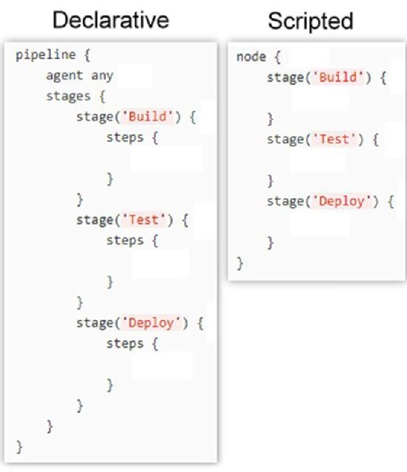
Ask Questions
Declarative pipeline starts with which tag?
node
pipeline
stage
step

Slide 9
Ask Questions
Which scripting language is used in Jenkins?
bash
python
groovy
perl

Slide 10
Ask Questions
Which function is used in pipeline to get the secrets/credentials?
withCredentials
withData
withSecret
withPassword

Slide 11
Interview / Certification Questions

Slide 12
Ask Questions
Amazon Virtual Private Cloud (Amazon VPC) enables you to launch AWS resources into a virtual network that you've defined. This virtual network closely resembles a traditional network that you'd operate in your own data center, with the benefits of using the scalable infrastructure of AWS.
For more information on AWS VPC, Refer: Link
Which of the following helps you set up a logically isolated section of your AWS cloud?
AWS Subnets
AWS VPC
AWS Regions
AWS Availability Zones

Slide 13
Interview/Certification Questions
VPC Peering can be established between VPCs in different AWS Regions and in separate AWS Accounts. The logical networks still use the same common AWS backbone network infrastructure to communicate. By utilizing this infrastructure, VPC Peering makes it possible to securely store mission-critical data to geographically distinct locations for fault-tolerance, disaster recovery and redundancy. Link
Option B. is INCORRECT because VPC Peering can still work without the use of public IP addresses. Private IP address subnets can be routed between peers as long as their respective CIDR block ranges do not overlap.
Option C. is INCORRECT because it is not permissible on the AWS cloud to route traffic of one VPC peer through a transitive peer to get to a third VPC. Link
Option D. is INCORRECT because traffic between VPC peers in different AWS Regions is indeed encrypted by default
Which statements regarding VPC Peering is accurate? Select TWO.
Two VPCs in different AWS Regions and under separate AWS Accounts can share traffic between each other.
In order for VPC Peering to work each VPC should have a public subnet.
In VPC Peering, it is possible for traffic from one VPC to traverse through a transit VPC in order to reach a third VPC.
Traffic between VPC peers in different AWS Regions is not encrypted by default.
VPC Peering can be used to replicate data to geographically distinct locations for fault-tolerance, disaster recovery and redundancy
Notes:
VPC Eşleme ile ilgili hangi ifadeler doğrudur? İKİ'yi seçin.Farklı
AWS Bölgelerindeki ve ayrı AWS Hesapları altındaki iki VPC, trafiği birbirleri arasında paylaşabilir.VPC Eşlemenin çalışması için her VPC'nin genel bir alt ağı olmalıdır.
VPC Eşlemede, bir VPC'den gelen trafiğin üçüncü bir VPC'ye ulaşmak için bir geçiş VPC'sinden geçmesi mümkündür.
Farklı AWS Bölgelerindeki VPC eşleri arasındaki trafik varsayılan olarak şifrelenmez.
VPC Eşleme, verileri hataya dayanıklılık, olağanüstü durum kurtarma ve yedeklilik için coğrafi olarak farklı konumlara kopyalamak için kullanılabilir

Slide 14
Interview/Certification Questions
A network access control list (ACL) is an optional layer of security for your VPC that acts as a firewall for controlling traffic in and out of one or more subnets. You might set up network ACLs with rules similar to your security groups in order to add an additional layer of security to your VPC.
For more information on Network ACL’s, Refer: Link
Which of the following security features is associated with a Subnet in a VPC to protect against Incoming traffic requests?
AWS Inspector
Subnet Groups
Security Groups
Network ACL

Slide 15
Interview/Certification Questions
Option C is incorrect because Route 53 is not used for load-balancing traffic among individual AWS resource instances (like a load balancer) rather we integrate it with resources for added functionality Link
Option E is incorrect. In AWS, Autoscaling is used to scale underlying resources up or down based on predetermined or dynamic factors.
Which of the following are the main functions of AWS Route 53? (SELECT THREE)
Register domain names
Route internet traffic to the resources for your domain
Load-balance traffic among individual AWS resource instances
Check the health of your resources
Auto Scale your resources

Slide 16
Interview/Certification Questions
In a disaster recovery scenario, the best choice out of all given options is to divert the traffic to a static website. Option A is wrong because ELB can only balance traffic in one region, not across multiple regions.
Options B and C are incorrect because using backups across AZs is not enough for disaster recovery purposes.
For more information on disaster recovery in AWS, please visit the following Links: Link-1, Link-2
The wording "to reduce the potential disruption in case of issues" is pointing to a disaster recovery situation. There is more than one way to manage this situation. However, we need to choose the best option from the list given
here. Out of this, the most suitable one is Option D.
There is a website hosted in AWS that might get a lot of traffic over the next couple of weeks. If the application experiences a natural disaster at this time, what should be used to reduce potential disruption to users?
Use an ELB to divert traffic to an Infrastructure hosted in another region.
Use an ELB to divert traffic to an Infrastructure hosted in another AZ.
Use CloudFormation to create backup resources in another AZ.
Use Route53 to route requests to another instance in a different region
Notes:
506 / 5.000
Çeviri sonuçları
star_border
AWS'de barındırılan ve önümüzdeki birkaç hafta içinde çok fazla trafik alabilecek bir web sitesi var. Uygulama şu anda bir doğal afet yaşarsa, kullanıcılarda olası kesintileri azaltmak için ne kullanılmalıdır?
Trafiği başka bir bölgede barındırılan bir Altyapıya yönlendirmek için bir ELB kullanın.
Trafiği başka bir AZ'de barındırılan bir Altyapıya yönlendirmek için bir ELB kullanın.
Başka bir AZ'de yedek kaynaklar oluşturmak için CloudFormation'ı kullanın.
İstekleri farklı bir bölgedeki başka bir örneğe yönlendirmek için Route53'ü kullanın

Slide 17
Article of the Week

Slide 18
Article of the Week
Ask what exactly each student does for the team, if they know each other, if they care for each other, if they follow and talk with each other etc.

Slide 19
Video of the Week

Slide 20
Video of the Week
Ask what exactly each student does for the team, if they know each other, if they care for each other, if they follow and talk with each other etc.

Slide 21
Retro Meeting on a personal and team level

Slide 22
Retro Meeting on a personal and team level
What went well?
What will we commit to do better in the next week?
What could be improved?

Slide 23
Coding Challenge

Slide 24
Coding Challenge
Coding Challenge - 09 : Convert Milliseconds into Hours, Minutes, and Seconds with Bash Scripting

Slide 25
Case study/Project

Slide 26
Case study/Project
Case study should be explained to the students during the weekly meeting and has to be completed in one week by the students. Students should work in small teams to complete the case study
Project-208: Jenkins Pipeline for Web Page Application (Postgresql-Nodejs-React) deployed on EC2's with Ansible and Docker

Slide 27
Closing

Slide 28

Closing
Next week’s plan
-QA Session

